Slide 1
Basic Arduino Workshop

Slide 2


Agenda
Introduction to Arduino
Introduction to Arduino IDE
Basic Functions
Practical 1: LED
Practical 2: Servo
Summary

Slide 3
Intro to Arduino

Slide 4

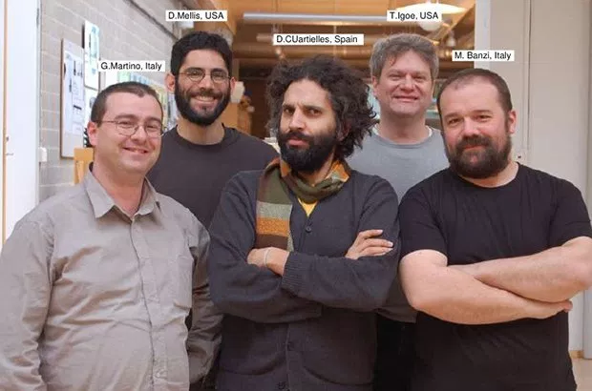
What is Arduino
Tool for IoT product development, project prototyping and DIP
Developers of Arduino
Notes:
Positioning

Slide 5
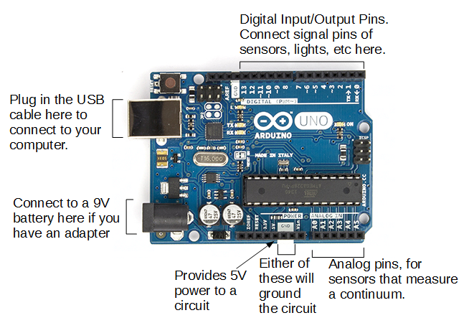

Arduino Board

Slide 6
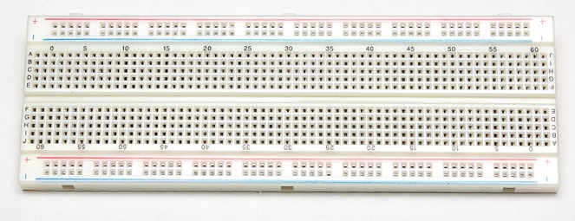
Breadboard
Connected Horizontally
Connection is broken here
Connected Vertically
Connection is broken here
Notes:
Circuit of breadboard

Slide 7
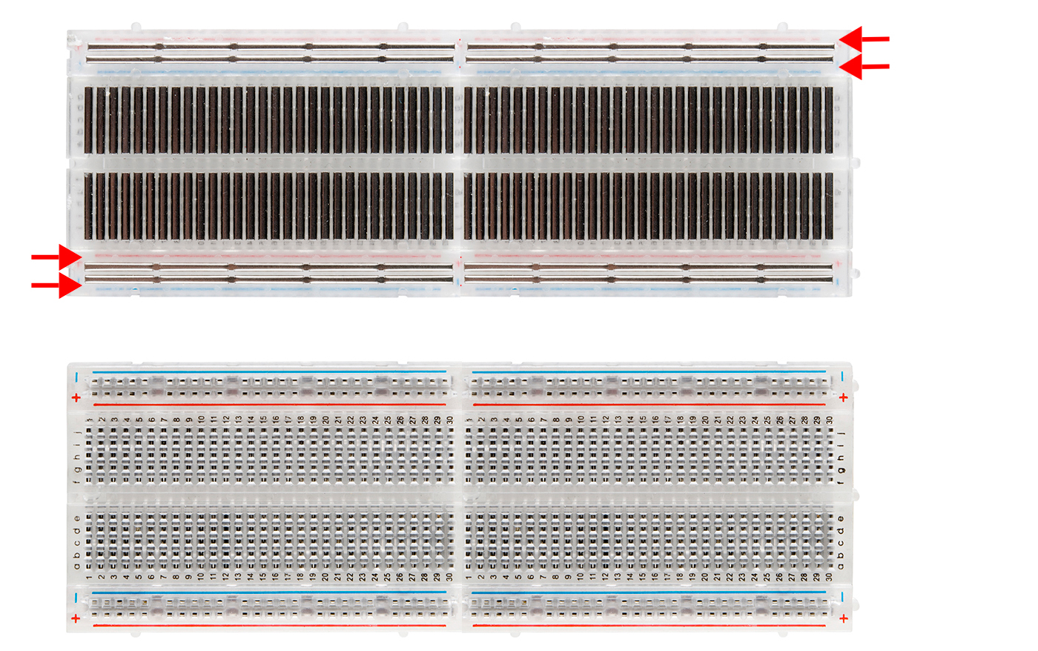
Breadboard
Notes:
Circuit of breadboard

Slide 8
Practical 1: LED

Slide 9
5V and Ground Pins
5V / 3.3V
3.3V is used depending on the component
Ex. Bluetooth Module
Ground
Represented by “gnd”

Slide 10
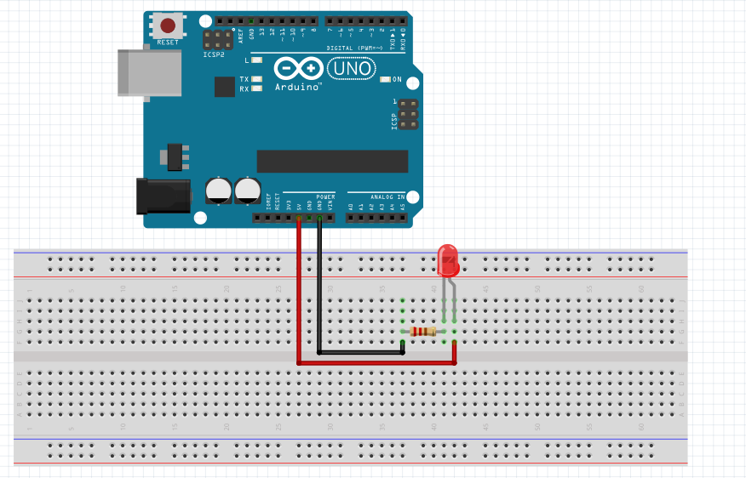
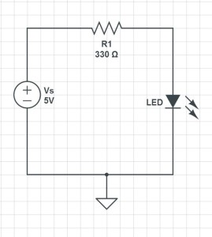
LED
Objective: To turn on the LED
Long end is connected to 5V
Opposite direction won’t work as it is a diode!
Notes:
Mention the use of resistor (limit the voltage), cathode and anode of the LED. White works at 3.3v, red is 1.5v

Slide 11
Digital Pins
12 Digital Pins (2 – 13)
0 or 1
1 = High Voltage (3.3V - 5V)
0 = Low Voltage (0V)

Slide 12
Basic Functions
pinMode(pin,mode)
Changes what the Pin does
Included within void setup()
Different Modes:
INPUT
OUTPUT
INPUT_PULLUP
digitalWrite(pin,mode)
Change the output of the digital pin
Mode values: HIGH or LOW (5V or 0V)

Slide 13
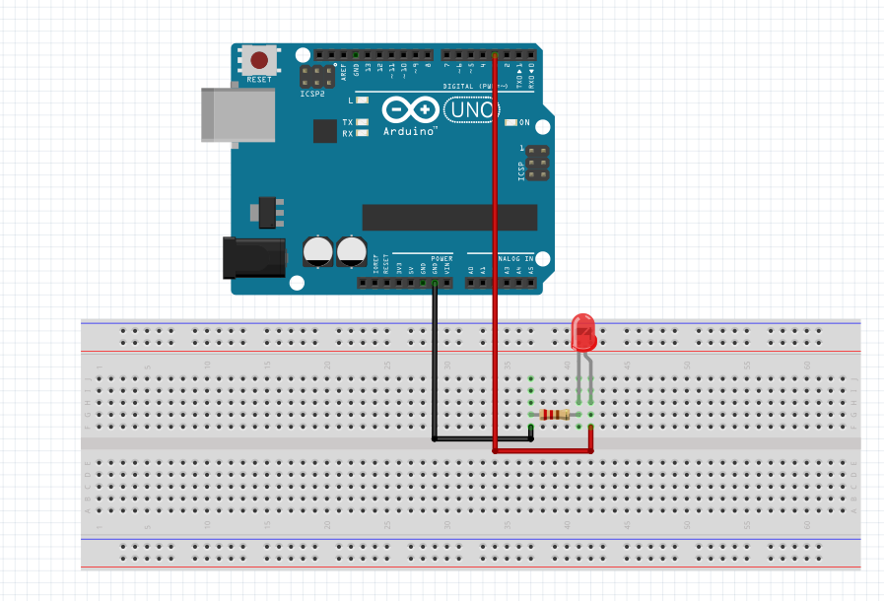
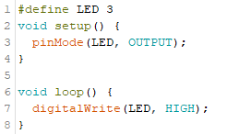
LED
Objective: To turn on the LED using digital pin
Notes:
Mention the use of resistor (limit the voltage), cathode and anode of the LED. White works at 3.3v, red is 1.5v

Slide 14
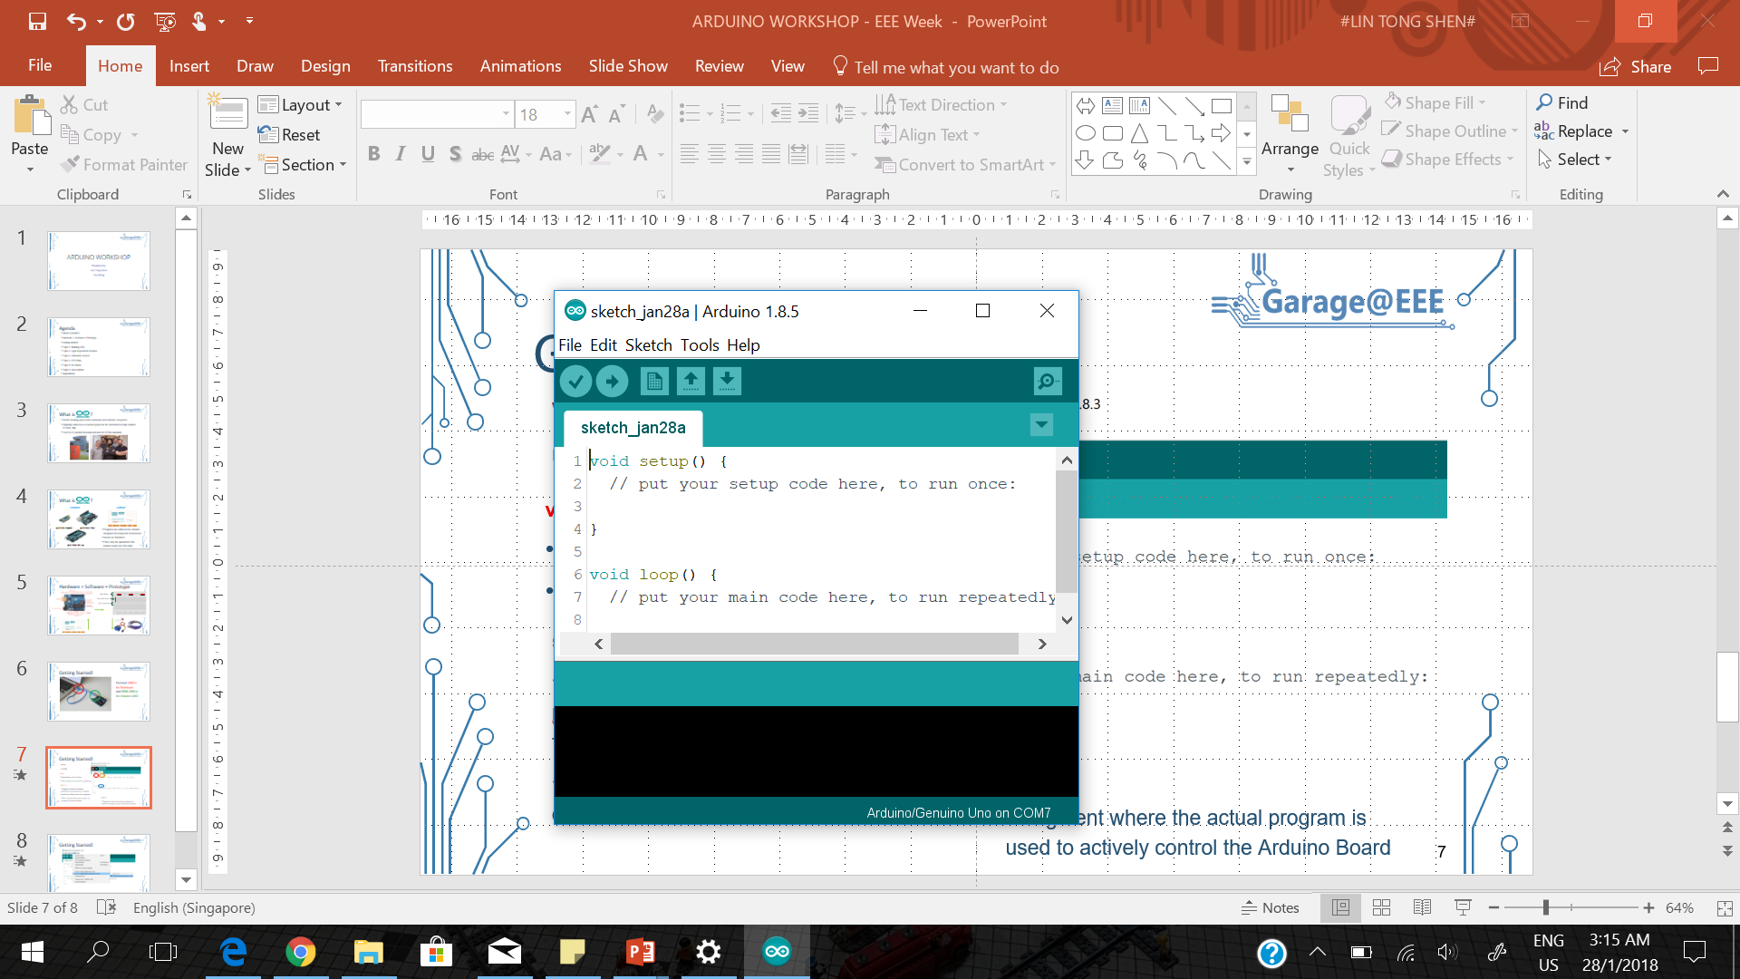
Arduino IDE
Verify
Compile and check for errors
Upload
Upload program
Serial Monitor
Arduino can communicate with the computer
Board Information

Slide 15
Arduino IDE
setup()
Segment where variables are declared and initialised
Only run once each time
loop()
Segment where the actual program is used to control the Arduino Board
Code in this segment will run continuously
Notes:
Machines and micro controller – do repetitive things (program a task)

Slide 16
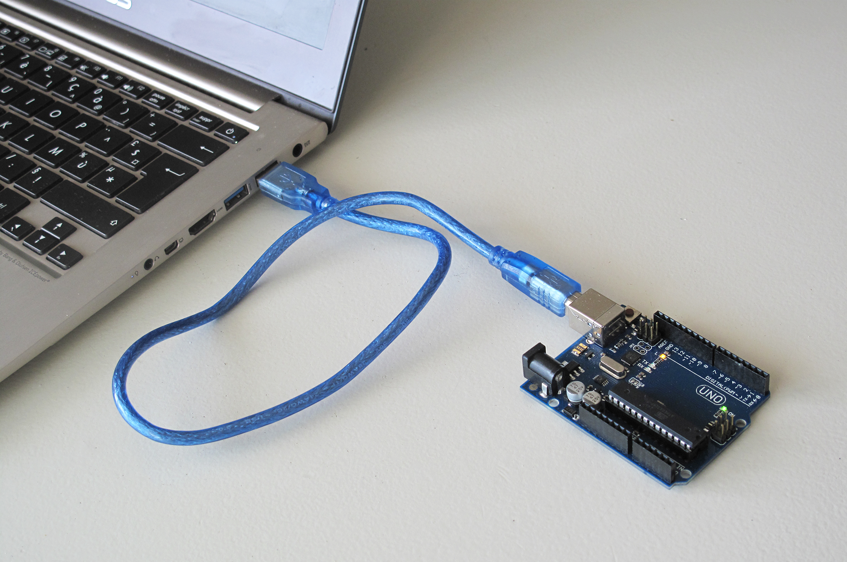
Get Started!
Connect USB to the Notebook and USB-B to the Arduino UNO

Slide 17
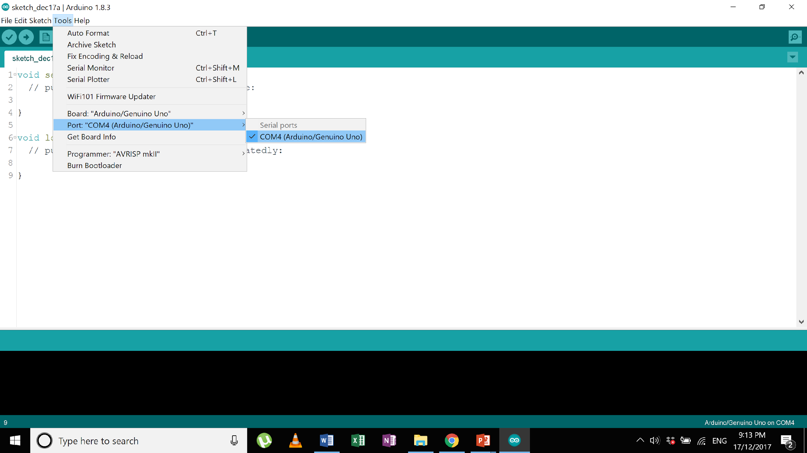
Get Started!
Ensure that “Arduino/Genuino Uno” is selected as the board: Tools > Board > Arduino/Genuino Uno
Ensure that “Arduino/Genuino Uno” is selected as the board: Tools > Port > COM[X] (Arduino/Genuino Uno)

Slide 18
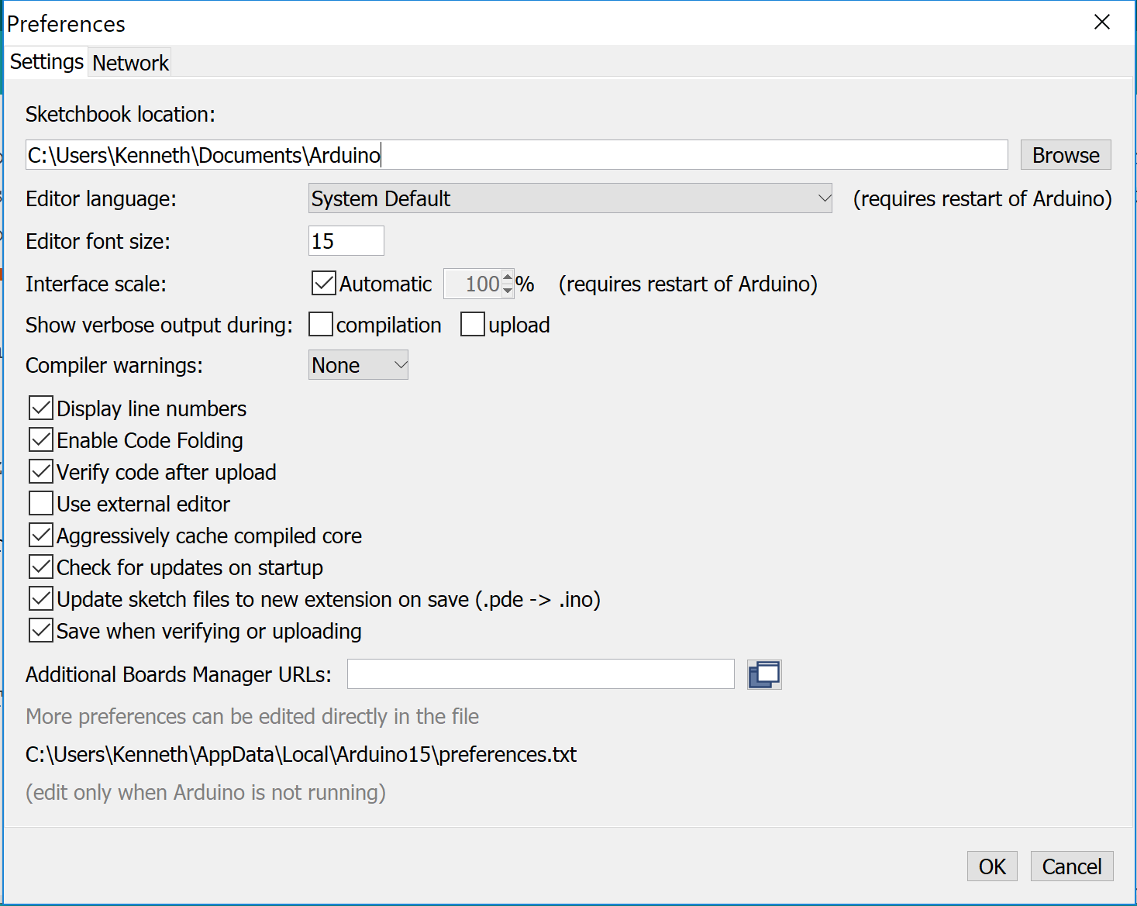
Enable Line Numbers
Under:
File > Preferences

Slide 19
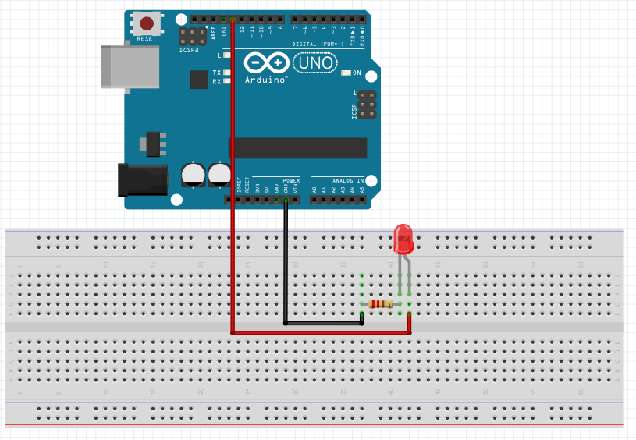
Blinking LED!
Objective: To turn on the LED and make it blink
How to make it blink?
It must turn off and on repeatedly
Use digital pins to control
Notes:
Mention the use of resistor (limit the voltage), cathode and anode of the LED. White works at 3.3v, red is 1.5v

Slide 20
Basic Functions
delay(value)
Pauses Arduino for a specified amount of time (milliseconds)
Able to control amount of time the LED is turned off and on

Slide 21
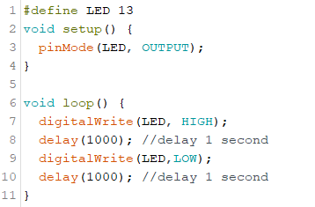
Blinking LED!
Objective: To turn on the LED and make it blink
Notes:
Mention the use of resistor (limit the voltage), cathode and anode of the LED. White works at 3.3v, red is 1.5v

Slide 22
Dimming LED!
Objective: Make the LED dimmer
Try to reduce the time between the LED turning on and off
It will blink very quickly, our eyes will perceive it to be dimmer
Vary the ratio of time on to time off
Notes:
Mention the use of resistor (limit the voltage), cathode and anode of the LED. White works at 3.3v, red is 1.5v

Slide 23

Digital Pins (PWM)
The digital pin can simulate analog output by varying ratio of time ON to time OFF.
Analog pins cannot be used to produce analog signals, only “Analog In”
Only PWM pins can produce analog values

Slide 24
Blinking LED! (without delay)
Objective: To turn on the LED and let it blink without using delay
Why do we avoid using delay?
Cannot run other tasks simultaneously
millis()
Returns time (in milliseconds) since the board started running
Overflow after 50 days
How do you use millis() to replace delay?
Notes:
Ask what is delay 1000

Slide 25
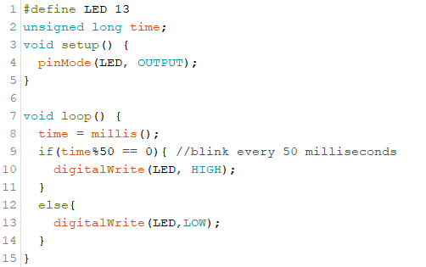
Blinking LED! (without delay)
Objective: To turn on the LED and let it blink without using delay
Modulo operator, the if condition returns true if time is a multiple of 50
Notes:
Explain time modulo 50

Slide 26
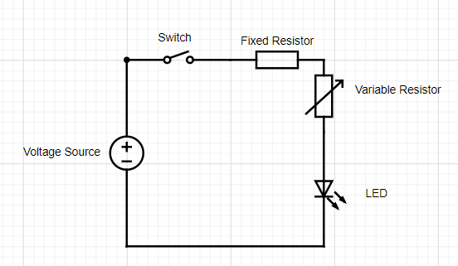
Variable Resistor and LED
Objective: To control the brightness of the LED with
a variable resistor without using a “circuit method” such as:
Notes:
Ask them whats the error,

Slide 27
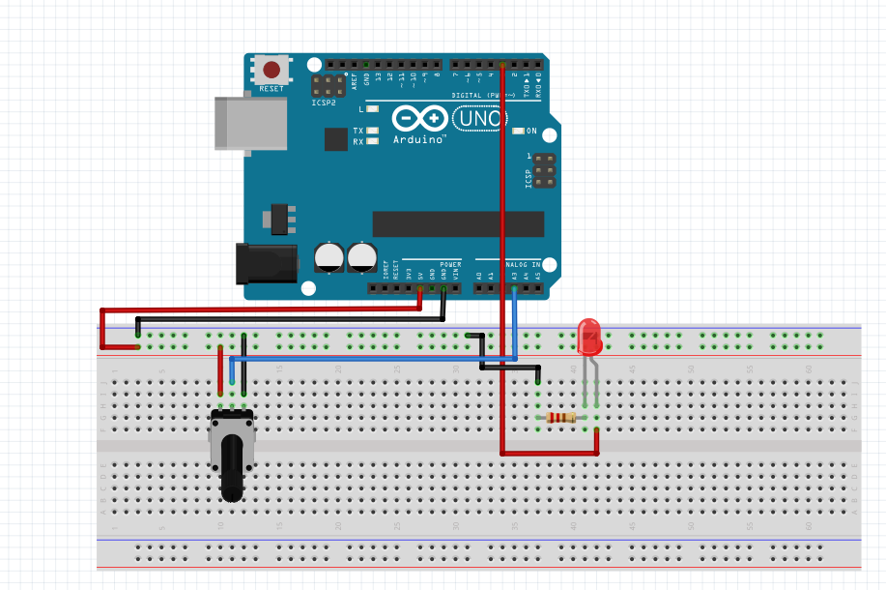
Variable Resistor and LED
Objective: To control the brightness of the LED with
a variable resistor without using a “circuit method”
A3
Notes:
Ask them whats the error,

Slide 28
Analog Pins
6 Analog Pins (A0 – A5)
inputs from 0 to 255 (0V – 5V)
output values from 0 to 1023 (0V – 5V)
analogRead(pin)
Returns (0 - 1023)
analogWrite(pin,value)
Change the output of the analog pin
Value range: (0 – 255) → Corresponds to 0V to 5V
Digital pins with PWM can use this function

Slide 29
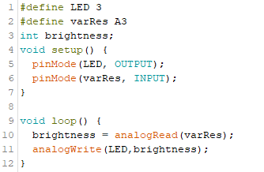
Variable Resistor and LED
Objective: To control the brightness of the LED with
a variable resistor without using a “circuit method”
WRONG
Notes:
Ask them whats the error,

Slide 30
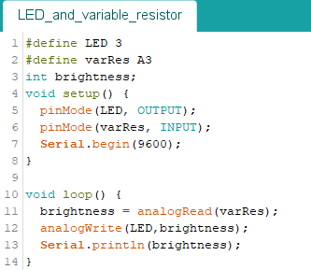
Variable Resistor and LED
Use Serial monitor to debug the code
Serial.begin(value) and Serial.println(value)
Serial.begin(value) is placed in setup()
Value must be specified, 9600 is commonly used

Slide 31
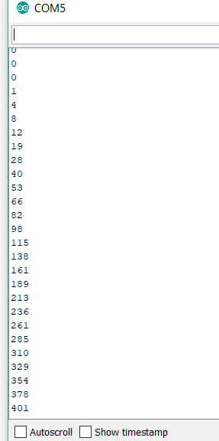
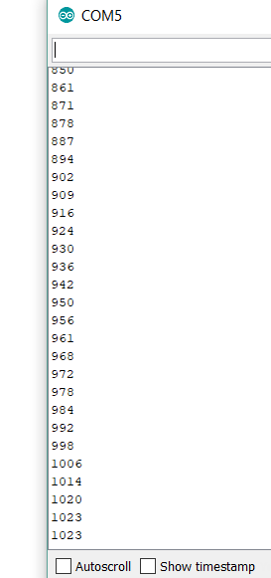
Variable Resistor and LED
Use Serial monitor to debug the code
What will appear on the Serial Monitor?
Values from 0 - 1023

Slide 32
Variable Resistor and LED
The output from analogRead(A3) ranges from 0 – 1023
However, analogWrite() only allow input values from 0 – 255
Hence, as the variable resistor is turned, the brightness of LED changes from dark to bright 3 times.
We need to use map function to limit the input values.
Notes:
Ask them whats the error,

Slide 33
Variable Resistor and LED
map(value, fromLow, fromHigh, toLow, toHigh)
Value : the number to map
fromLow : the lower bound of the value’s current range
fromHigh : the upper bound of the value’s current range
toLow : the lower bound of the value’s target range
toHigh : the upper bound of the value’s target range

Slide 34
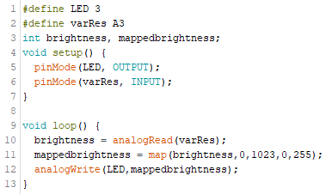
Variable Resistor and LED
Map the values from analogRead to (0,255)
Notes:
Add a slide for other types of variable resistor

Slide 35
Practical 2: Servo

Slide 36
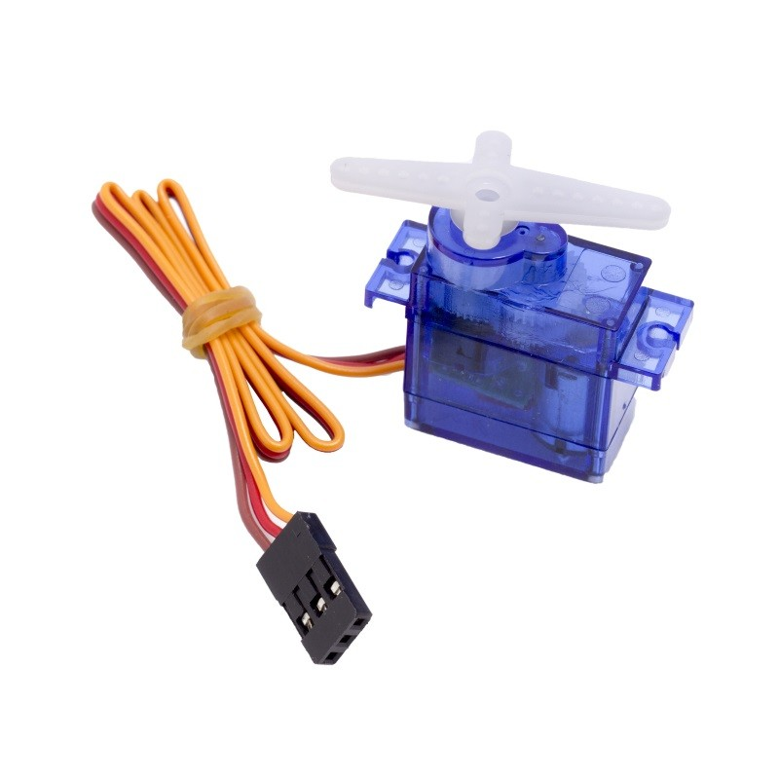
Servo!
Allow the shaft to be positioned at various angles, usually between 0 and 180 degrees.
It is different from a motor which is able to rotate 360 degrees.
Notes:
Explain the diff between servo and motor

Slide 37
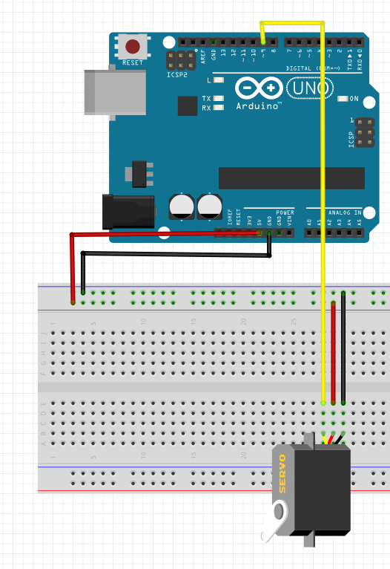
Turning a Servo
Objective: To make the shaft turn
Connect:
Yellow wire -> pin 9
Red wire -> 5V
Brown wire -> Ground
Notes:
Put note that the angle is from 0 to 180. Servo isn’t a motor, cant be used for wheels

Slide 38
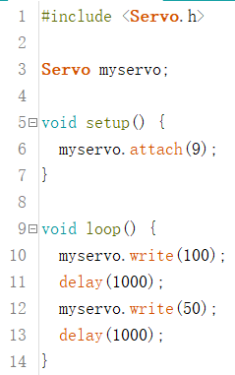
Turning a Servo
Objective: To make the shaft turn
} Include library
} Initialization
} Using pin 9 to
connect servo motor
} Rotate to 100 degrees
} Wait for 1 second
} Rotate back to 50°
} Wait for 1 second
Notes:
Put note that the angle is from 0 to 180. Servo isn’t a motor, cant be used for wheels

Slide 39
Turning a Servo with a variable resistor
Objective:
Make the variable into a “joy stick”, such that when the variable resistor is turned to the left beyond a certain point, the servo turns left. When the variable resistor is turned to the right beyond a certain point, the variable resistor turns right.

Slide 40
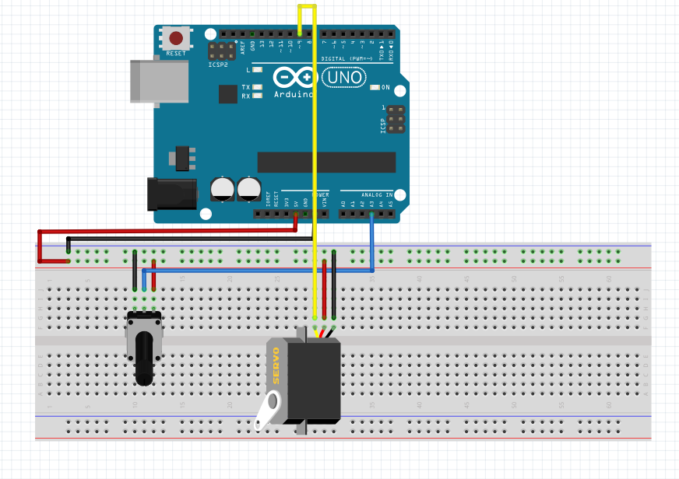
Turning a Servo with a variable resistor
Circuit:

Slide 41
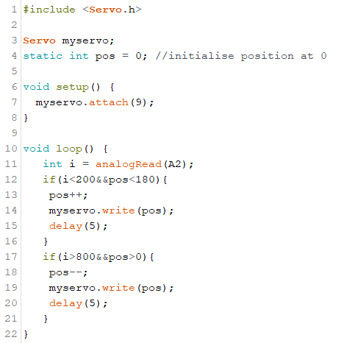
Turning a Servo with a variable resistor
If the resistor is turned to the left and the position of the servo is less than the maximum
Code:

Slide 42
Summary

Slide 43
Digital and Analog Pins
12 Digital Pins (2 – 13)
0 or 1
1 = High Voltage (3.3V - 5V)
0 = Low Voltage (0V)
6 Analog Pins (A0 – A5)
inputs from 0 to 255 (0V – 5V)

Slide 44
Other Important Pins
5V / 3.3V
3.3V is used depending on the component
Ex. Bluetooth Module, 5V would damage the component
Ground
Abbreviated by “grd”

Slide 45
Basic Functions
pinMode(pin,mode)
Changes what the Pin does
Included within void setup()
Pull Up Circuit
Ensures that the digital input is either 0 or 1
Built within the Arduino Board
Important when making a button
Different Modes:
INPUT
OUTPUT
INPUT_PULLUP → activate the pull up circuit

Slide 46
Basic Functions
digitalWrite(pin,mode)
Change the output of the digital pin
Mode values: HIGH or LOW (5V or 0V)
analogWrite(pin,value)
Change the output of the analog pin
Value range: (0-255) → Corresponds to a range from 0V to 5V
Digital pins with PWM can use this function

Slide 47
Basic Functions
digitalRead(pin)
Returns 0 or 1
analogRead(pin)
Returns (0 - 1023)
Serial.begin(value) and Serial.println(value)
Serial.begin(value) is placed in setup()
Value must be specified, 9600 is commonly used
Allow the Arduino board to communicate
9600 (rate at which Arduino is communicating with the computer)

Slide 48
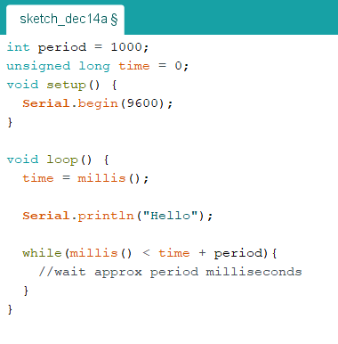
Basic Functions
delay(value)
Pauses Arduino for a specified amount of time (milliseconds)
(-) Cannot run other tasks simultaneously
millis()
Returns time (in milliseconds) since the board started running
Overflow after 50 days
Example of millis() to replace delay()
Notes:
Ask what is delay 1000

Slide 49
Basic Functions
map(value, fromLow, fromHigh, toLow, toHigh)
Value : the number to map
fromLow : the lower bound of the value’s current range
fromHigh : the upper bound of the value’s current range
toLow : the lower bound of the value’s target range
toHigh : the upper bound of the value’s target range
Notes:
Ask what is delay 1000

Slide 50
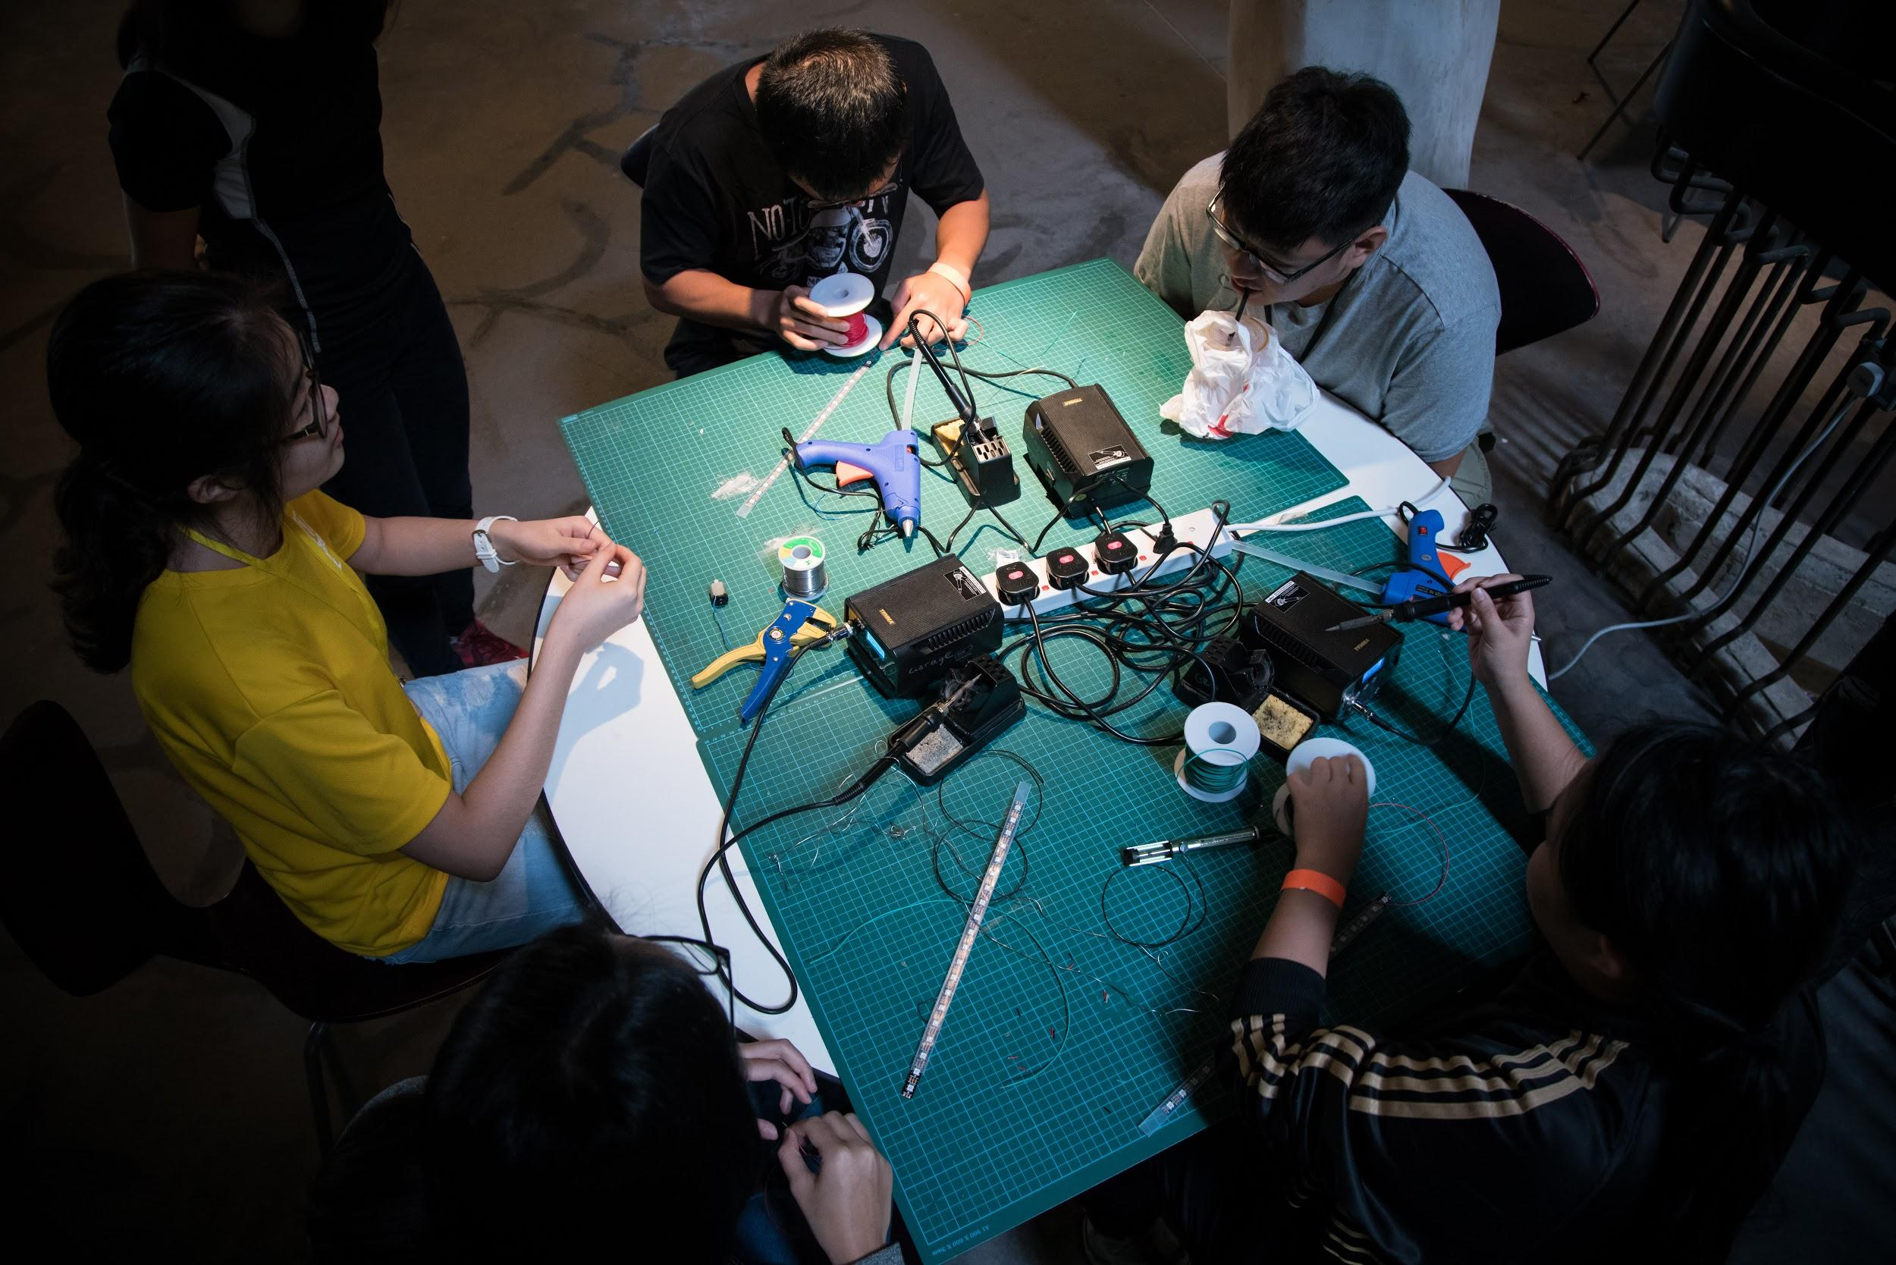

Thank You!

Slide 51
Appendix

Slide 52
Appendix - Digital Pins (PWM)
The digital pin can simulate analog output.
Analog value is modulated (i.e. represented) by a digital signal
Analog pins cannot be used to produce analog signals, only “Analog In”

Slide 53
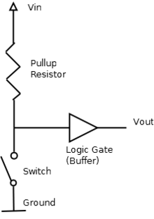
Appendix – Pullup Circuit
Pull Up Circuit
Ensures that the digital input is either 0 or 1
Built within the Arduino Board
Important when making a button

